Slide 1


Incognito
PROBLEM - 1
PROBLEM - 1
MFA Authentication

Slide 2



Multi-factor authentication (MFA) - PURPOSE
Additional verification beyond a username and password
Prevent against Phishing
Secure Against packet reply attacks
Reduce fraud and build secure system
Prevent from Man-in-the-Middle attacks
Increase productivity and flexibility - Access any device or location-without putting sensitive data at risk
Commonly used are
Security questions
SMS (short messaging service) messages
Push Notification
04

Slide 3
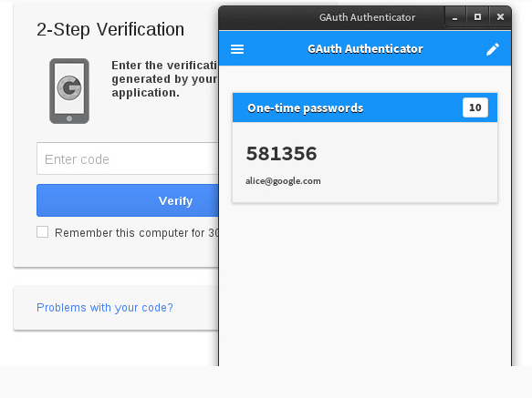
MFA – Sending TOTP via GOTP
04
User is asked to scan a QR image using a specific smartphone application. Application then continuously generates the One Time Password for the user
TOTP (the Time-based One-Time Password algorithm)

Slide 4

MFA – Sending TOTP via Email
Whenever a user cannot access their mobile device for authentication, they can use their verified email to complete authentication.
04

Slide 5

MFA – Sending OTP via SMS
TP Identity Management
Okta
Auth0
Any phone capable of receiving SMS text messages can be used to receive one-time codes.
Every time the user logs in, they receive a text message to their registered phone number, which contains a One Time Password.
04

Slide 6
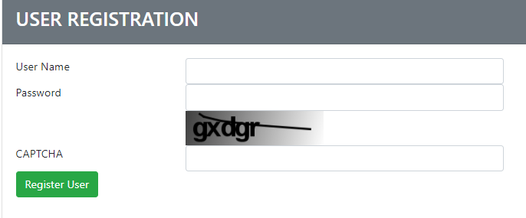
MFA – reCAPTCHA
Asking users to identify letters whereas letters are distorted so that bots are not likely to be able to identify them.
To pass the test, users have to interpret the distorted text, type the correct letters into a form field, and submit the form. If the letters don't match, users are prompted to try again.
Easy for People. Hard for Bots.
Block Automated Software
04

Slide 7
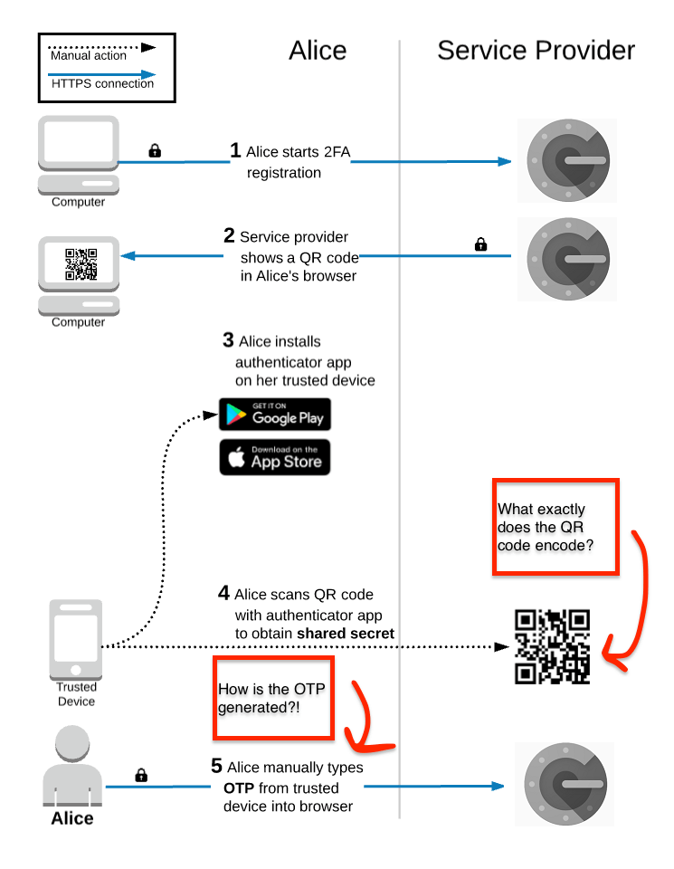
Technical Workflow - GOTP
04

Slide 8
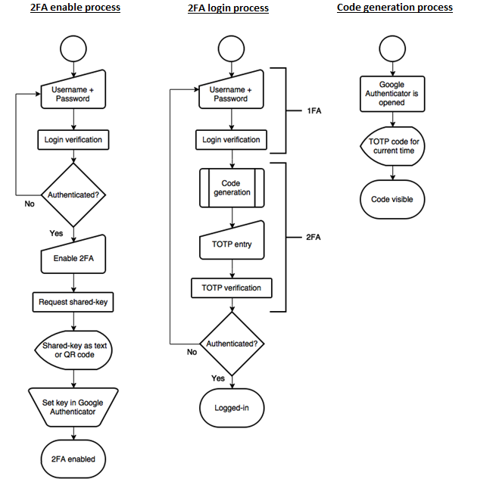
Functional Workflow - GOTP
04

Slide 9

KG Information Systems Private Limited
THANK YOU
www.kgisl.com

